Slide 1
CSE-431 Individual
Presentation
Presented by
Fardin Zaman
ID:20301473
Section:02

Slide 2
Introduction
A language is characterized as a system of rules or a collection of symbols that are integrated and used to transmit or broadcast information. Actually, natural language processing is a branch of artificial intelligence and linguistics that focuses on teaching computers to comprehend words or sentences written in human languages. It was created to make user work easier and to fulfill the desire for natural language communication between users and computers.

Slide 3
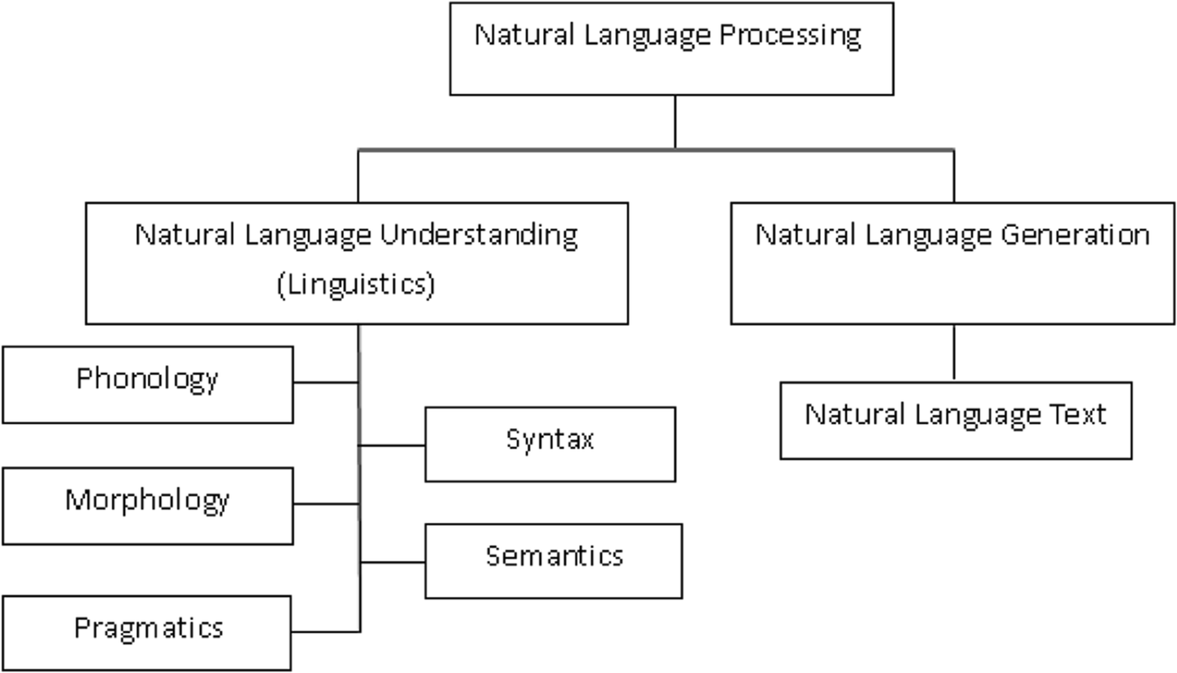
It can be classified into two parts which are Natural Language Understanding and Natural Language Generation which evolves the task to understand and generate the text.
Notes:
‹#›

Slide 4
Abstract
Computer intelligent recognition technology describes the application of machine learning, computer vision, natural language processing, and other technologies to make computers capable of recognizing, interpreting, and responding to human language and behavior. Target tracking, NLP, face recognition, picture recognition, and other domains are among the common uses of computer intelligent recognition technologies. Natural language processing (NLP) is a branch of computer science that studies how computers and natural languages interact. Text, audio, and picture data that contains natural language can be processed, analyzed, and produced using NLP technology. Language translation, emotion analysis, text classification, speech recognition, and question-answering systems are a few common uses for NLP technology.
Notes:
‹#›

Slide 5
Natural language processing as a means of computing modeling and interpreting human language. Its uses have expanded to a number of domains, including email spam detection and machine translation. We first identify four stages by going through the various NLP levels and NLP components, then we go into the background and development of NLP. After that, we go into great length about the state of the art, outlining the numerous uses for NLP as well as present trends and difficulties.
Notes:
‹#›

Slide 6
Different Natural language Components
There are three Natural language Components.
Components and Levels of Representation: The process of language generation involves the following interweaved tasks.
Application or Speaker: This is only for maintaining the model of the situation. Here the speaker just initiates the process doesn’t take part in the language generation.
Speaker and Generator

Slide 7
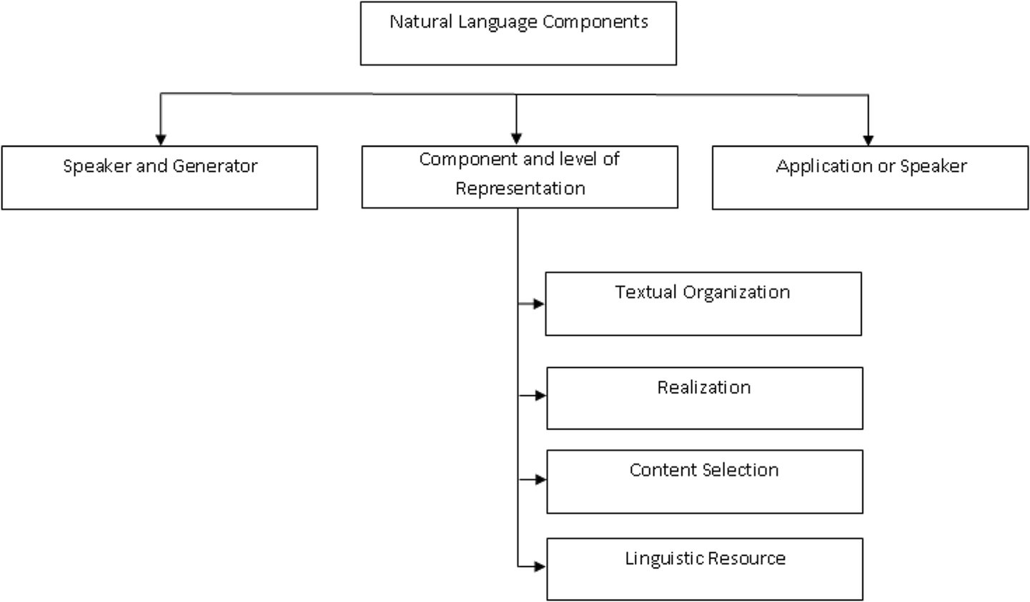

Slide 8
The Evaluation of NLP
In the late 1940s the term NLP wasn’t in existence, but the work regarding machine translation had started. In fact, NLP research almost died. In early 1980s computational grammar theory became a very active area of research linked with logics for meaning. Some researcher demonstrated that rhetorical schemes could be used for producing both linguistically coherent and communicatively effective text. Information extraction and automatic summarizing was also a point of focus.
Notes:
‹#›

Slide 9
Recent Development on NLP
Neural language modeling was introduced in the early 2000s, where the likelihood of a given word appearing given n preceding words is calculated. The feed forward neural network and lookup table concepts, which represent the n preceding words in succession, were proposed. Parts-of-speech and named entity recognition tagging were carried out using two convolutional models with max pooling. in their proposal for the use of multitask learning in NLP. A word embedding procedure that addressed the dense vector representation of text was presented. Additionally, they discuss the difficulties that conventional sparse bag-of-words representation faces.

Slide 10
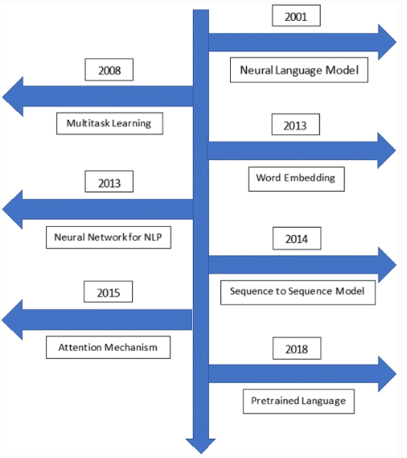

Slide 11
Limitation of NLP
Errors in text and speech: Misspelled or misused words can create problems for text analysis. Autocorrect and grammar correction applications can handle common mistakes, but don’t always understand the writer’s intention.
Low-resource languages: AI machine learning NLP applications have been largely built for the most common, widely used languages. And it’s downright amazing at how accurate translation systems have become. However, many languages, especially those spoken by people with less access to technology often go overlooked and under processed.
Notes:
‹#›

Slide 12
Development time : Along similar lines, you also need to think about the development time for an NLP system.
Innate biases
Words with multiple meanings
False positives and uncertainty
Notes:
‹#›

Slide 13
Conclusion
Natural Language Processing, a technology that uses sophisticated algorithms and perceptive analysis, is beginning to change how we interact with the outside world. Digital assistants, chatbots, voice search, and a plethora of other uses we can't even begin to anticipate have all been made possible by NLP.
Naturally, NLP isn't quite on an endless growth trend. NLP developers are still dealing with a lot of problems.

